Slide 1
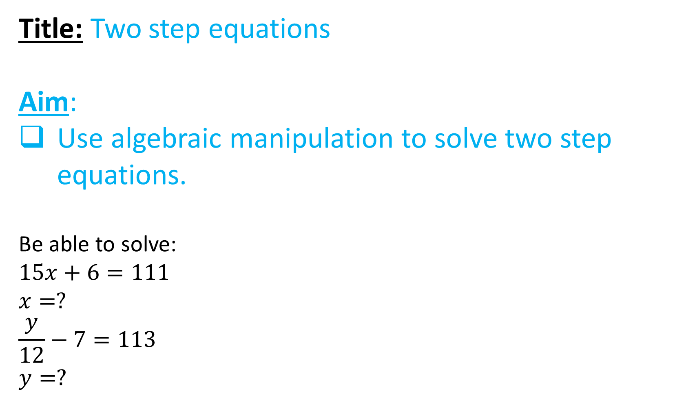
Title: Two step equations
Aim:
Use algebraic manipulation to solve two step equations.
Be able to solve:
$$15x+6=111$$
$$x=?$$
$$\frac{y}{12}−7=113$$
$$y=?$$

Slide 2
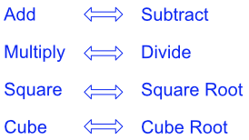
Inverse Operation

Slide 3
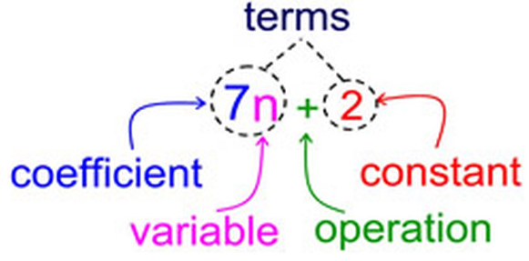
Constance are sometimes referred to as number terms

Slide 4
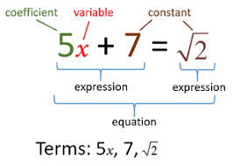
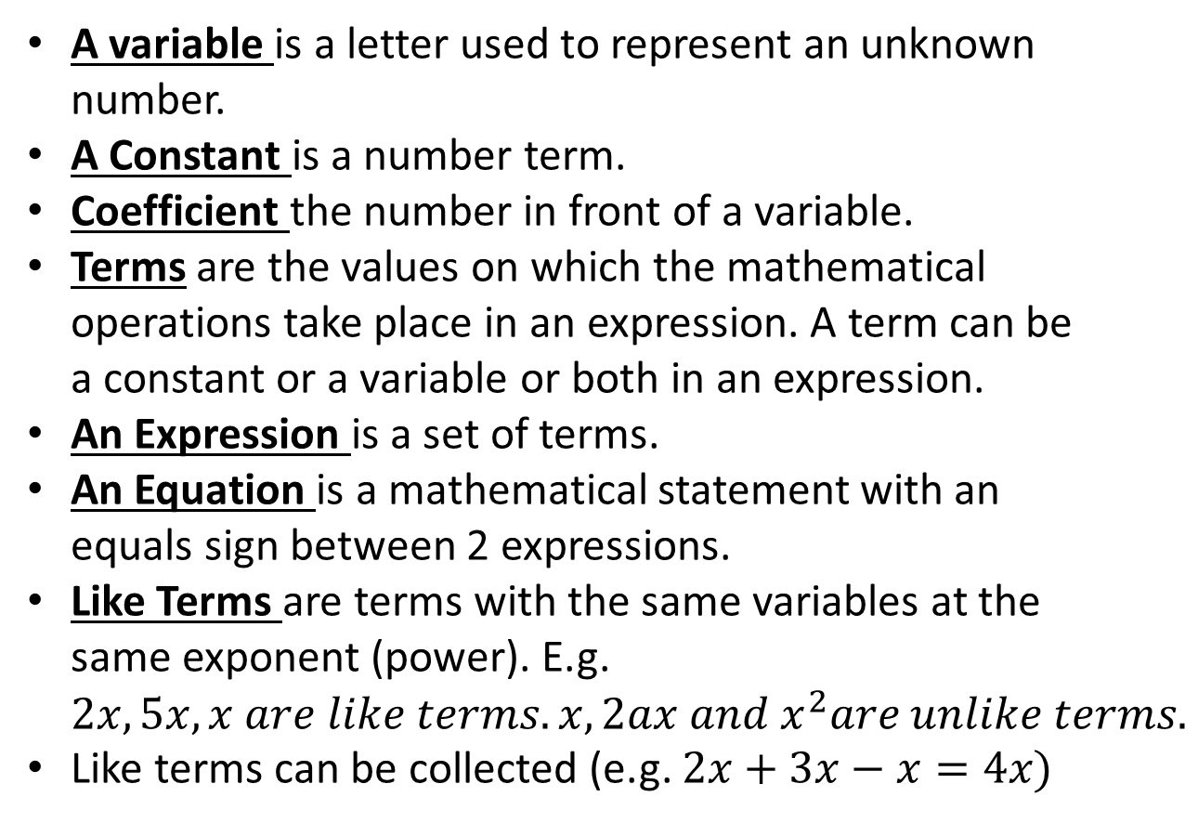
Reteach
A variable is a letter used to represent an unknown number.
A Constant is a number term.
Coefficient the number in front of a variable.
Terms are the values on which the mathematical operations take place in an expression. A term can be a constant or a variable or both in an expression.
An Expression is a set of terms.
An Equation is a mathematical statement with an equals sign between 2 expressions.
Like Terms are terms with the same variables at the same exponent (power). E.g. $2x, 5x, x are like terms. x, 2ax and x^{2}are unlike terms.$
Like terms can be collected (e.g. $2x+3x−x=4x)$

Slide 5

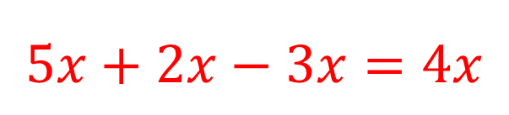
Pair and share
$$5x+2x+3y−3x+y^{2}+1$$
How many expressions are there?
How many terms are there?
what is the sum of the coefficients?
How many like terms are their?
If the like terms are collected what will they equal?
1
6
5+2+3-3+1+1=9
Three ($5x, 2x, −3x)$
$$5x+2x−3x=4x$$

Slide 6





Solving one step equations:
What you do to one side you do to the other.
Equation solving steps:
Simplify both sides
Collect variable terms to left and numbers to right – swap sides swap signs.
Simplify both sides
Divide both sides by coefficient.
Simplify both sides
Substitute back into original question to verify
$$x+2=5$$
$$5x=12$$
$$−2x=12$$
$$x−6=11$$
$$\frac{x}{2}=9$$

Slide 7





Your Turn
Solving one step equations:
What you do to one side you do to the other.
Equation solving steps:
Simplify both sides
Collect variable terms to left and numbers to right – swap sides swap signs.
Simplify both sides
Divide both sides by coefficient.
Simplify both sides
Substitute back into original question to verify
$$x+4=9$$
$$x−7=15$$
$$−6x=24$$
$$4x=20$$
$$\frac{x}{3}=2$$

Slide 8




Solving two step equations:
What you do to one side you do to the other.
Equation solving steps:
Simplify both sides
Collect variable terms to left and numbers to right – swap sides swap signs.
Simplify both sides
Divide both sides by coefficient.
Simplify both sides
Substitute back into original question to verify
$$3x+2=9$$
$$2x−8=13$$
$$5−x=−1$$
$$3x+(−2)=10$$

Slide 9




Your Turn
Solving two step equations:
What you do to one side you do to the other.
$$5x+6=30$$
$$4x−3=12$$
Equation solving steps:
Simplify both sides
Collect variable terms to left and numbers to right – swap sides swap signs.
Simplify both sides
Divide both sides by coefficient.
Simplify both sides
Substitute back into original question to verify
$$5−3x=−3$$
$$3x+(−4)=10$$

Slide 10
Individual practice
Calculated colouring 23

